Slide 2
Using Project “Orleans” to build Halo Cloud services in Windows Azure
3-641
Hoop Somuah & Sergey Bykov

Slide 3


Slide 4
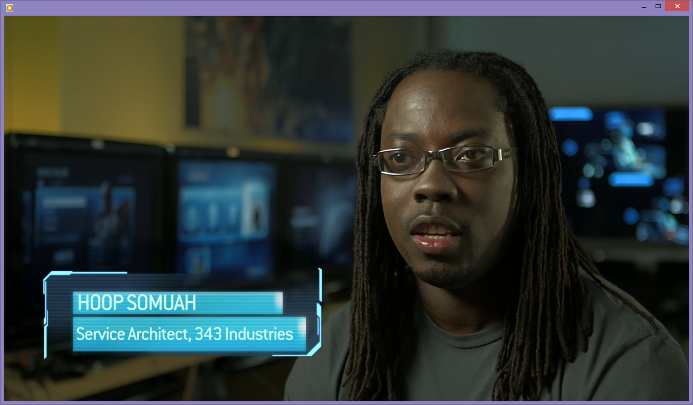
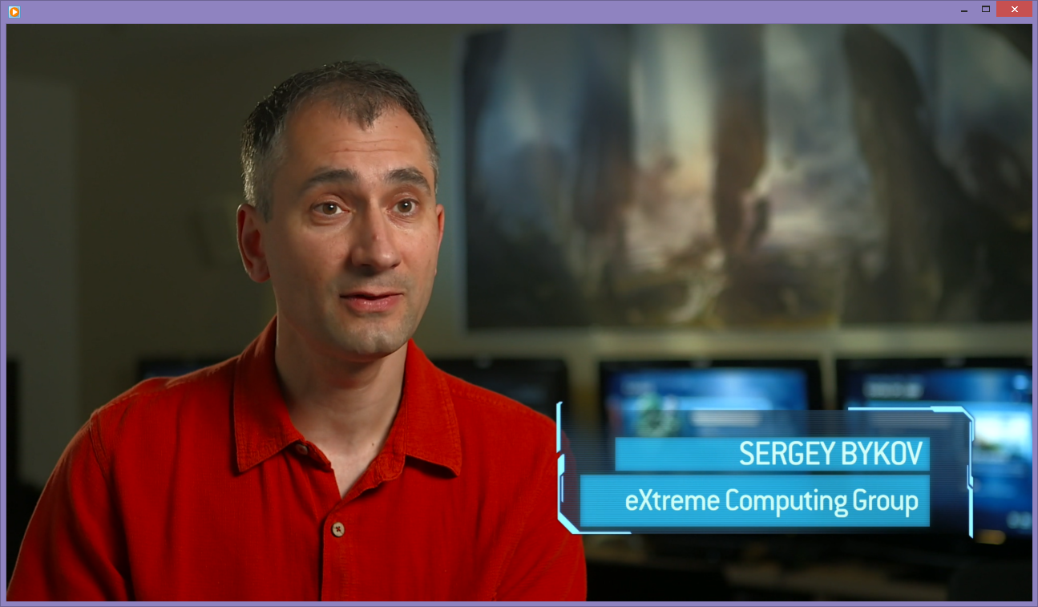
About us

Slide 5
Project “Orleans”: a programming model and runtime for building cloud native services

Slide 6


Slide 7
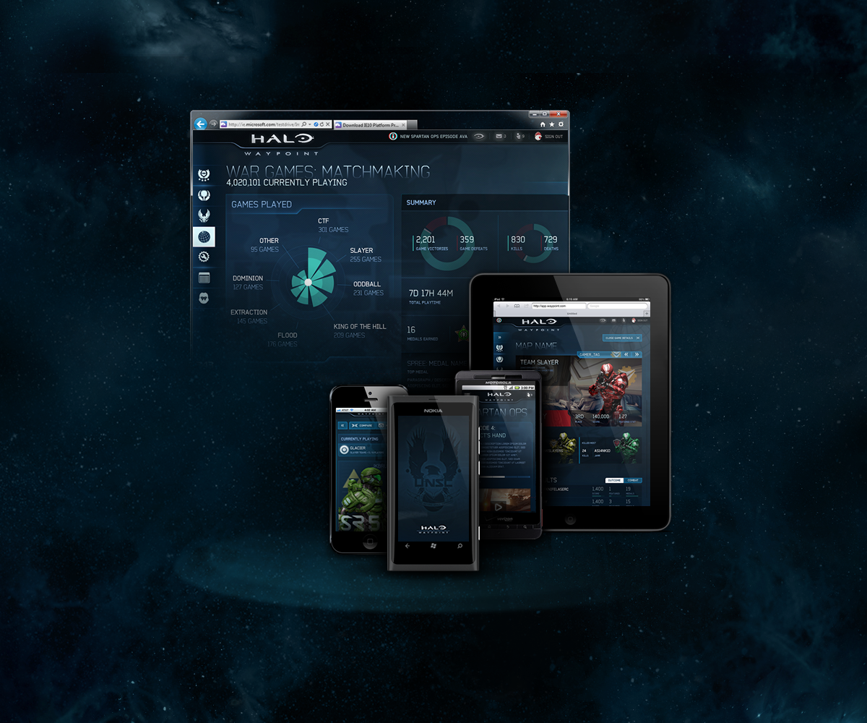


Slide 8
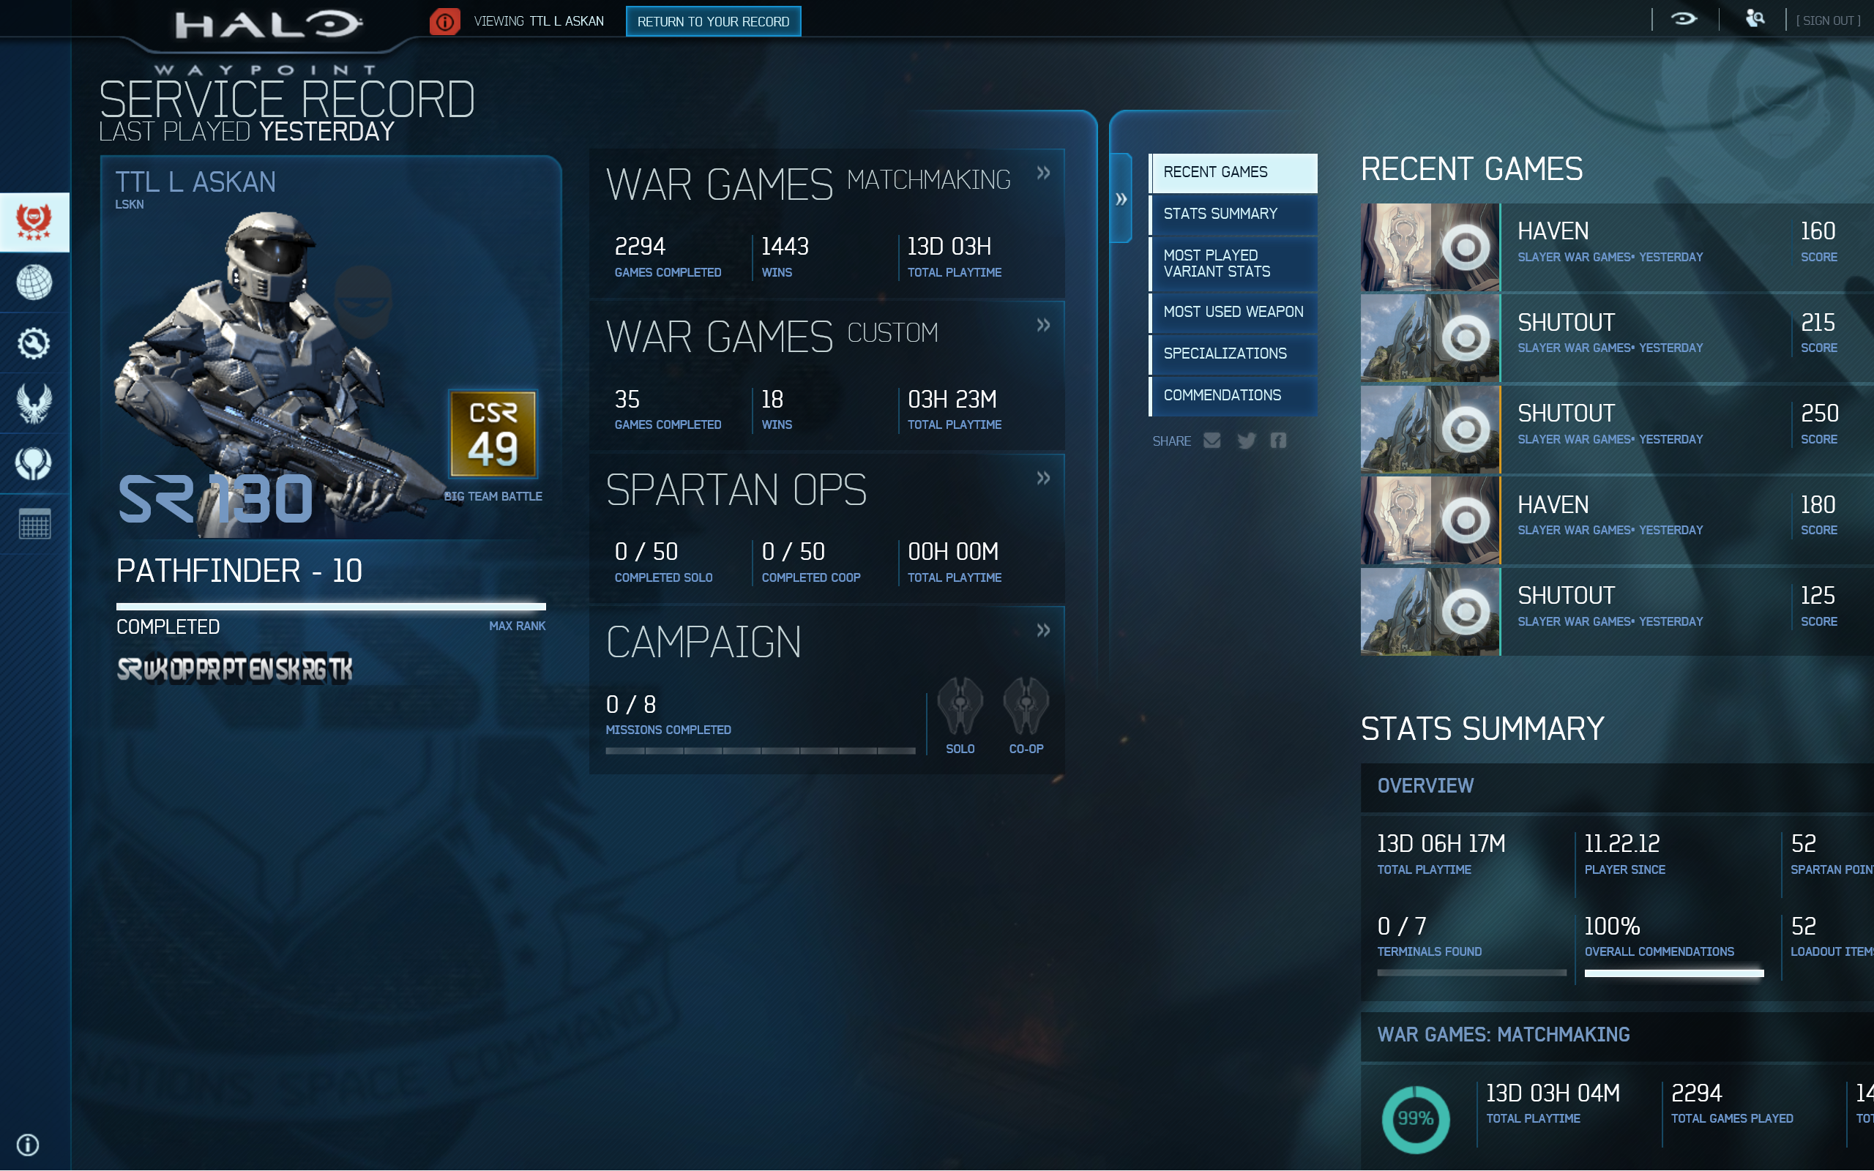

Slide 9
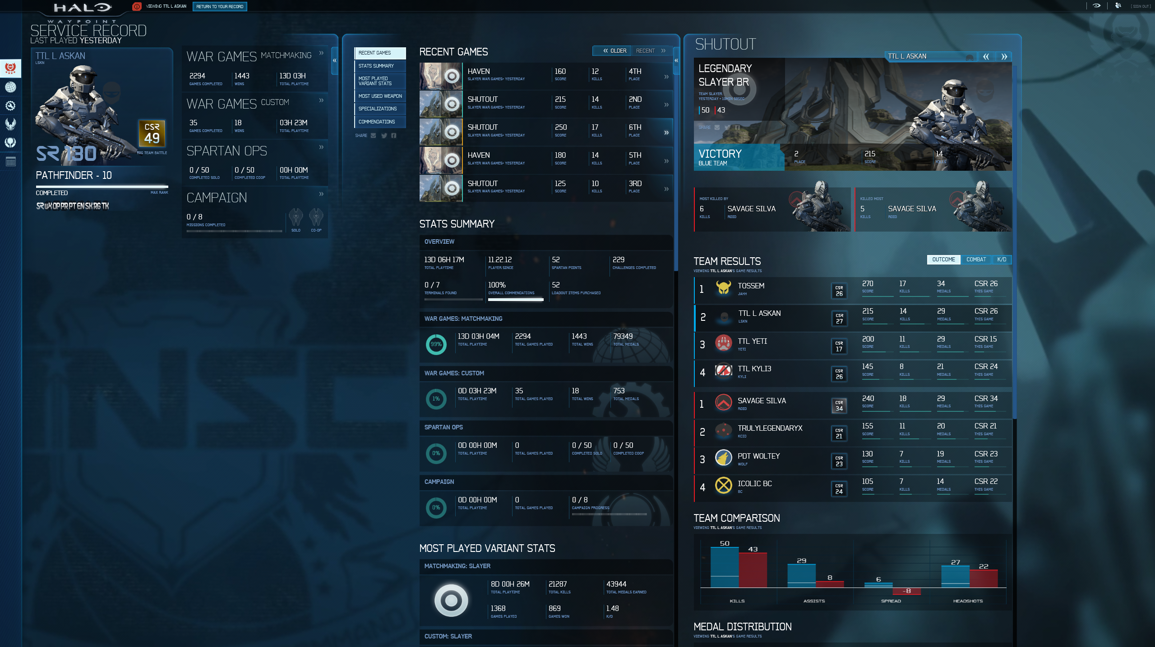

Slide 10
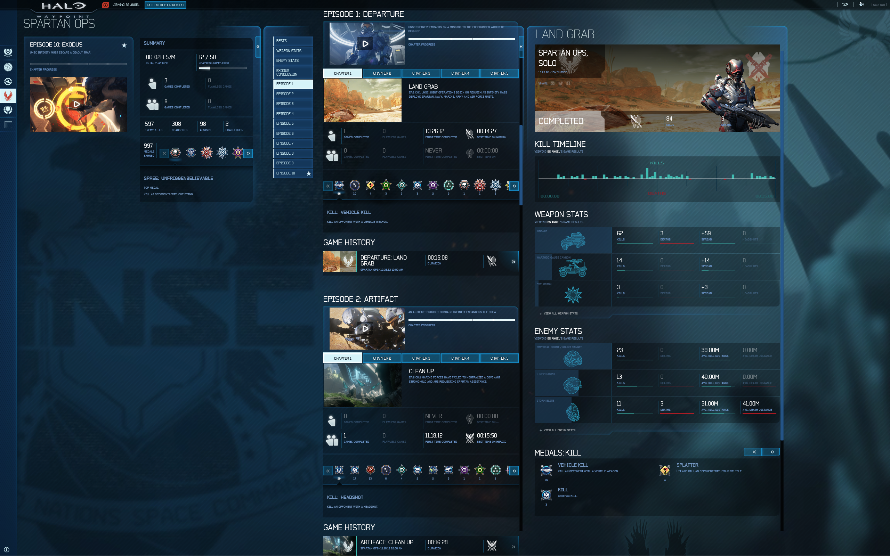

Slide 11
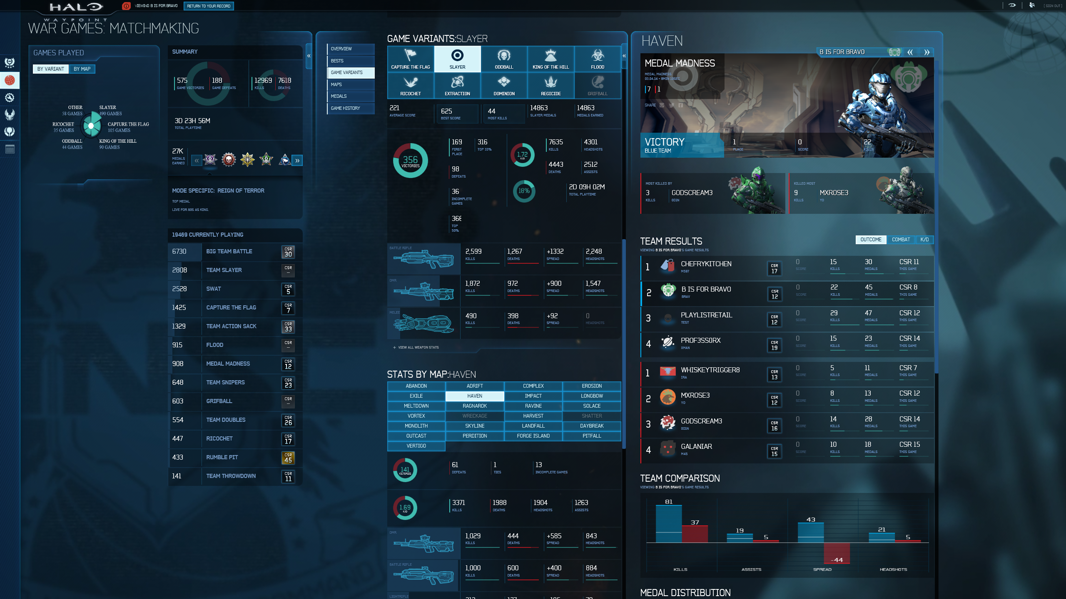

Slide 12

Waking up the Chief
Skill & Ranking
Cheat Detection
Presence & Matchmaking
Challenges & Unlockables
Game History
Profile
User Generated Content
Content Management Service

Slide 13
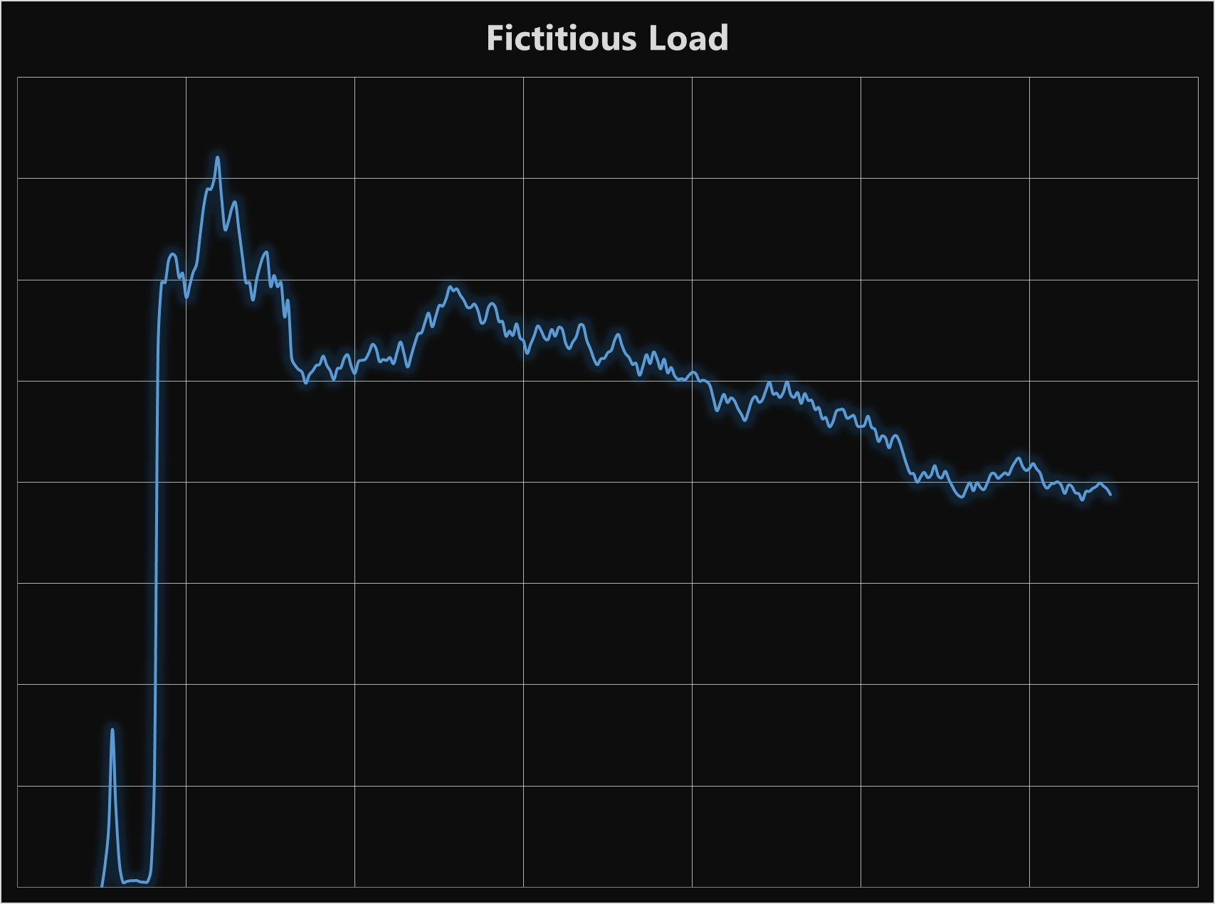
Patterns of a big game launch
Huge traffic spike on launch
Downtime at launch is really bad
Also spikes on weekends and holidays
Load steadies out over time

Slide 14
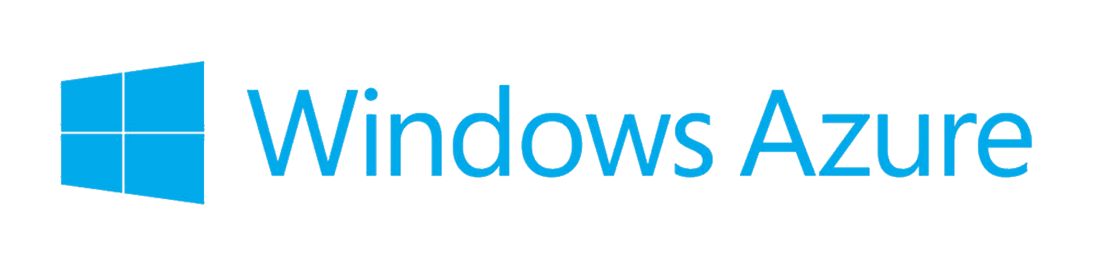
Cloud computing to the rescue

Slide 15
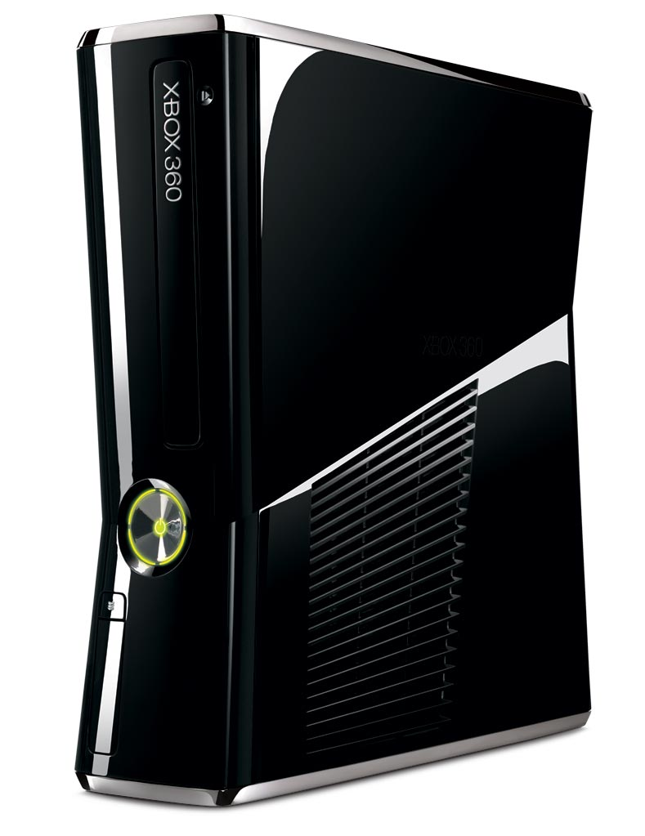
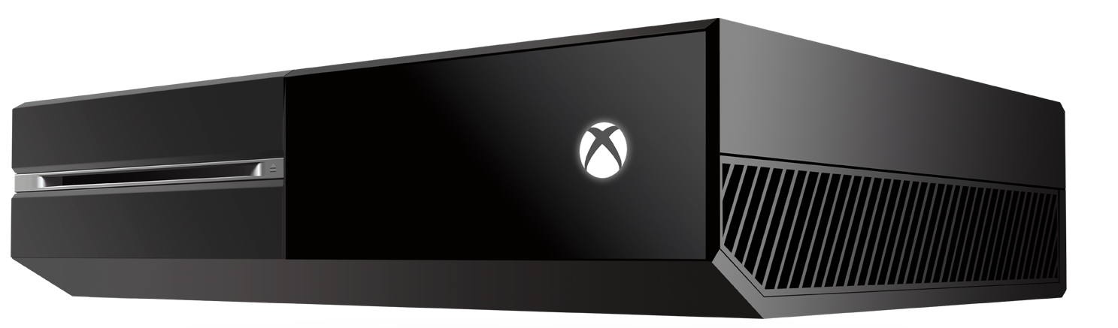



The Halo Cloud stack (2014)
Search
Azure
Load-Balancer
Azure Storage
Front Door
Compute
Worker Roles
HDInsight
Hadoop
Visualization

Slide 16
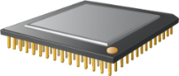
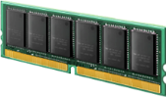


Warehouse computer
Search
Azure
Load-Balancer
Azure Storage
Front Door
Compute
Worker Roles
HDInsight
Hadoop
Visualization

Slide 17
Problem: concurrency is hard* Distribution, high throughput and low-latency make it even harder
*Correctness, performance and robustness are difficult to achieve in the face of concurrency

Slide 18
The Actor Model
Mathematical theory of computation
Introduced in 1973 by Hewitt, Bishop, and Steiger
A framework and basis for reasoning about concurrency
Actors as primitives of concurrent computation

Slide 19
Project “Orleans”
Distributed Actor runtime
Virtual Actor model
Location transparency
Built for .Net
Actors (Grains) are .Net objects
Messaging through .Net interfaces
Asynchronous through async/await in C#
Automatic error propagation
Silo: runtime execution container
Implicit activation & lifecycle management
Coordinated placement
Multiplexed communication
Failure recovery
Grain
Silo

Slide 20
Actors in “Orleans”: Grains
Game Grain (Instance) #2,548,308
Game Grain #2,548,308
Activation #1 @ 192.168.1.1
Game Grain Type
Game Grain (Instance) #2,031,769
Game Grain #2,031,769
Activation #1 @ 192.168.1.5
Grain Type
Grain (Instance)
Grain Activation

Slide 21
A cloud native runtime
New Activation
New Activations
Unavailable Silo
New Silo

Slide 22
Grains: Virtual actors
Grain instances always exist, virtually
Needn’t be created, looked up or deleted
Code can always call methods the grain
Grains never fail
Activations are created on-demand
If there is no existing activation, a message sent to it triggers instantiation
Lifecycle is managed by the runtime
Transparent recovery from server failures
Runtime can create multiple activations of stateless grains (for performance)
Location transparency
Grains can pass references to one another around
References can be persisted to cold-storage

Slide 23
Grain execution model
Activations are single-threaded
Optionally re-entrant
Runtime schedules execution of methods
Multiplexed across threads
No shared state
Avoid races
No need for locks
Cooperative multitasking

Slide 24
The grain developer experience

Slide 25
Grain interfaces
Marker interface to indicate grain interfaces
public interface IHello : IGrain
{
Task<string> SayHello(string greeting);
}
All grain interface methods must be asynchronous

Slide 26
Implementing the grain type
public class HelloGrain : GrainBase, IHello
{
Task<string> SayHello(string greeting)
{
var resp = "You said: '" + greeting + "', I say: Hello!";
return Task.FromResult(resp);
}
}

Slide 27
Talking to grains
Factory Class is auto-generated at compile time
private async static Task SendMessage(long grainId)
{
IHello friend = HelloFactory.GetGrain(grainId);
string response = await friend.SayHello("Good morning!");
Console.WriteLine("Response: {0}", response);
}
Grain Id (long , GUID or String)

Slide 28
A more detailed example: presence

Slide 29

Presence service
Near-real-time processing
State is mostly in memory
Constantly evolving social graph
A fraction of total user base online
Very high throughput, low latency
Inherent races
Mobile
Client
Game
Client
Game Session Grain A
Player Grain X
Game Session Grain B
Player Grain Y
Presence
(Router)
Grains
Game Session Grain C
Player Grain Z

Slide 30
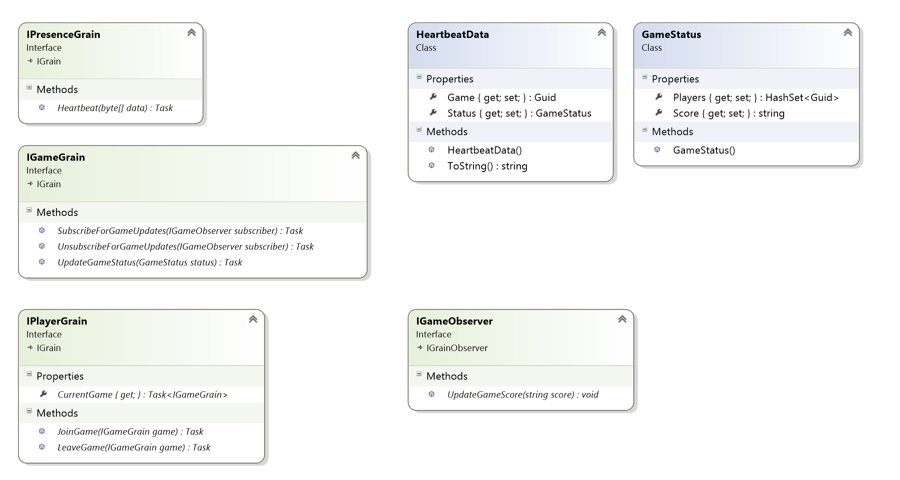
Presence service
Mobile
Client
Game
Client
Game Session Grain A
Player Grain X
Game Session Grain B
Player Grain Y
Presence
(Router)
Grains
Game Session Grain C
Player Grain Z

Slide 31
Heartbeat
Mobile
Client
Game
Client
Game Session Grain A
Player Grain X
Game Session Grain B
Player Grain Y
Presence
(Router)
Grains
Game Session Grain C
Player Grain Z

Slide 32
Heartbeat
public class PresenceGrain : GrainBase, IPresenceGrain
{
public Task Heartbeat(byte[] data)
{
HeartbeatData heartbeatData
= Heartbeat.Decrypt(data);
IGameGrain game = GameGrainFactory.GetGrain(heartbeatData.Game);
return game.UpdateGameStatus(heartbeatData.Status);
}
}

Slide 33
Game session grain
public class GameGrain : GrainBase, IGameGrain
{
private GameStatus status;
private ObserverSubscriptionManager<IGameObserver> subscribers;
private HashSet<Guid> players;
public override Task ActivateAsync() { … }
public override Task DeactivateAsync() { … }
public Task SubscribeForGameUpdates(IGameObserver subscriber)
{
subscribers.Subscribe(subscriber);
return TaskDone.Done;
}
}

Slide 34
Update game status
Mobile
Client
Game
Client
Game Session Grain A
Player Grain X
Game Session Grain B
Player Grain Y
Presence
(Router)
Grains
Game Session Grain C
Player Grain Z

Slide 35
Update game status
Check for new players that joined since last update
public async Task UpdateGameStatus(GameStatus status)
{
this.status = status;
foreach(Guid player in status.Players)
if(!players.Contains(player))
{
try
{
IPlayerGrain playerGrain = PlayerGrainFactory.GetGrain(player);
await playerGrain.JoinGame(this);
players.Add(player);
}
catch (Exception)
{
}
}
}
Here we call player grains serially, which is less efficient than a fan-out but simpler to express
Easily pass a reference to this Grain
Ignore exceptions. Since we didn't add the player to the list, this will be tried again with next update

Slide 36
Update game status
Check for players that left the game since last update.
Here we do a fan-out with multiple calls going out and build up a list of the Tasks. We collectively wait on the Tasks later. This results in more parallel work
public async Task UpdateGameStatus(GameStatus status)
{
…
List<Task> promises = new List<Task>();
foreach(Guid player in players)
if (!status.Players.Contains(player))
{
try
{
promises.Add(PlayerGrainFactory.GetGrain(player).LeaveGame(this));
players.Remove(player);
}
catch (Exception)
{ }
}
await Task.WhenAll(promises);
}
Wait on all of the Tasks

Slide 37
Update game status
public async Task UpdateGameStatus(GameStatus status)
{
…
subscribers.Notify((s) => s.UpdateGameScore(status.Score));
}
Notify subscribers about the latest game score

Slide 38
Player grain
Mobile
Client
Game
Client
Game Session Grain A
Player Grain X
Game Session Grain B
Player Grain Y
Presence
(Router)
Grains
Game Session Grain C
Player Grain Z

Slide 39
Player grain
public class PlayerGrain : GrainBase, IPlayerGrain
{
private IGameGrain currentGame;
public Task JoinGame(IGameGrain game)
{
currentGame = game;
return TaskDone.Done;
}
public Task LeaveGame(IGameGrain game)
{
currentGame = null;
return TaskDone.Done;
}
}

Slide 40
Client observer
Mobile
Client
Game
Client
Game Session Grain A
Player Grain X
Game Session Grain B
Player Grain Y
Presence
(Router)
Grains
Game Session Grain C
Player Grain Z

Slide 41
Grain observers
public interface IGameObserver : IGrainObserver
{
void UpdateGameScore(string score);
}
private class GameObserver : IGameObserver
{
public void UpdateGameScore(string score)
{
Console.WriteLine("New game score: {0}", score);
}
}

Slide 42
Client observer: subscribing
IPlayerGrain player = PlayerGrainFactory.GetGrain(playerId);
game = await player.CurrentGame;
if (game != null)
{
// Subscribe for updates
var watcher = new GameObserver();
IGameObserver reference = await GameObserverFactory.CreateObjectReference(watcher);
game.SubscribeForGameUpdates(reference).Wait();
}
Create a Pseudo-Grain Reference

Slide 43
“Orleans” was built for…
Scenarios
Social graphs
Mobile backend
Internet of things
Real-time analytics
‘Intelligent’ cache
Interactive entertainment
Common characteristics
Large numbers of independent actors
Free-form relations
High throughput/low latency
These generally dictate stateful compute
Fine-Grained partitioning is natural
Cloud-based scale-out & elasticity
Much broader developer audience

Slide 44
[Near] real-time analytics
Devices send telemetry to the Cloud
Per-device actors process and pre-aggregate incoming data
Multi-level aggregation by actors
Statistics, predictive analytics, fraud detection, etc.
Control channel back to devices
Grouping by location, category, etc.
Elastically scales with # of devices

Slide 45
Intelligent cache
Actors hold cache values
Semantic operation on values
Function shipping (method calls)
Coordination across multiple values
Automatic LRU eviction
Transparent on-demand reactivation
Write-through cache with optional batching

Slide 46
Halo’s “Orleans” experience
Search
Azure
Load Balancer
Azure Storage
Front Doors
“Orleans”
Silos
HDInsight
Hadoop
Visualization

Slide 47


Developer productivity
Familiar programming paradigm
Fewer concurrency hazard concerns and headaches
Smooth learning curve for engineers new to asynchronous programming
Simplified failure handling through error propagation
Faster development through separation of concerns
What’s a Server?
“Orleans” Runtime
Virtual Machines
Physical Machines

Slide 48
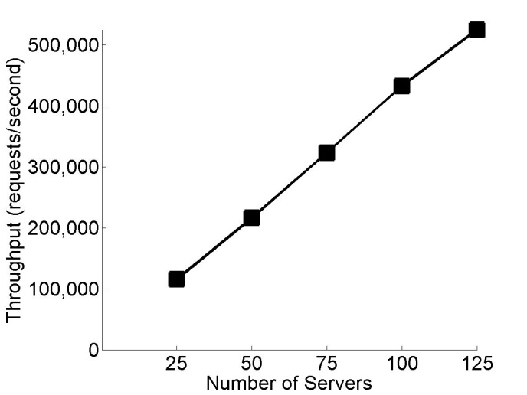
Scalability by default
Test Lab Numbers
Near linear scaling to hundreds of thousands of requests per second
Efficient resource usage
Location transparency simplifies scaling up or down
Complements Azure PaaS
Easily adjust scale over time

Slide 49
Get the preview: http://aka.ms/orleans Get the samples: https://orleans.codeplex.com/ Check out Halo Waypoint http://www.halowaypoint.com/

Slide 50

Your Feedback is Important
Fill out an evaluation of this session and help shape future events.
Scan the QR code to evaluate this session on your mobile device.
You’ll also be entered into a daily prize drawing!

Slide 51

© 2014 Microsoft Corporation. All rights reserved. Microsoft, Windows, Windows Vista and other product names are or may be registered trademarks and/or trademarks in the U.S. and/or other countries.
The information herein is for informational purposes only and represents the current view of Microsoft Corporation as of the date of this presentation. Because Microsoft must respond to changing market conditions, it should not be interpreted to be a commitment on the part of Microsoft, and Microsoft cannot guarantee the accuracy of any information provided after the date of this presentation. MICROSOFT MAKES NO WARRANTIES, EXPRESS, IMPLIED OR STATUTORY, AS TO THE INFORMATION IN THIS PRESENTATION.

